Slide 1
Board #3 The Bandpass Filter
Tuesday March 7, 2022

Slide 2
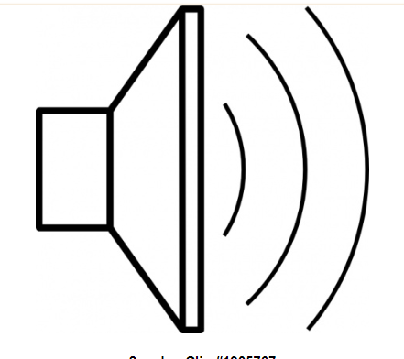
The Bandpass filter filters our all other frequencies, but lets the 40 meter BAND PASS
Bandpass
Filter
Mixer
Audio Amplifier
Oscillator
(VFO or PTO)

Slide 3
How the Parallel Tuned Circuit Filters

Slide 4
We use Two Parallel Tuned Circuits

Slide 5
First, glue down the pads, and tin the pads (scuff up the board too!)

Slide 6
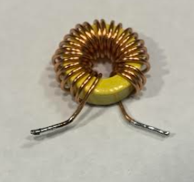
Wind the main coils on two toroidal cores (Note: Many hams are scared of this!)
Here is a video on how to do this:
(113) How to Wind a Toroidal Transformer -- March 5, 2023 – YouTube

Slide 7
Test the filter’s frequency response There will be a prize!

Slide 8
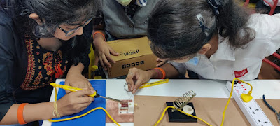
You are not alone! From Hyderabad, India

Slide 9
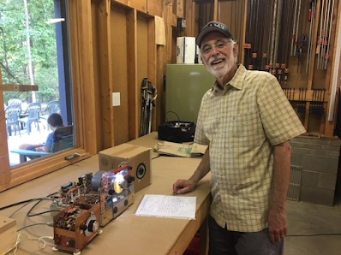
A real contact has been made with your receiver!

Slide 10
A Homework Design Challenge: How would you layout the 4th board? Where would you put the pads for the AF amp?

